Slide 1
4.5.1 Web Server IIS
Have fun!!!

Slide 2
What is Web Server IIS?
IIS = Internet Information Services
Runs on Microsoft (possible to run on Linux, but unstable)
Web server = process for hosting web applications; cannot have Internet without web servers
Pretty sure you guys interact with the Internet daily… XD

Slide 3
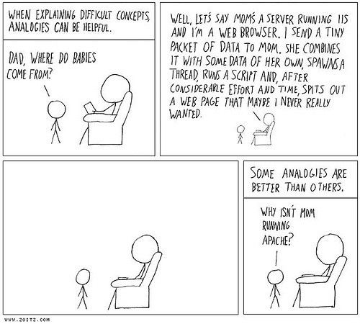
Web comic

Slide 4
More On Web Server IIS
Commonly used to host ASP.NET web applications & static websites
Can also be used as an FTP server, host WCF services, also extended to host web applications
Built-in authentication: Basic, Windows Auth, etc
Built-in security: TLS, binding for HTTPS and SFTP
Key feature: application pool
Segregates multiple applications from each other

Slide 5
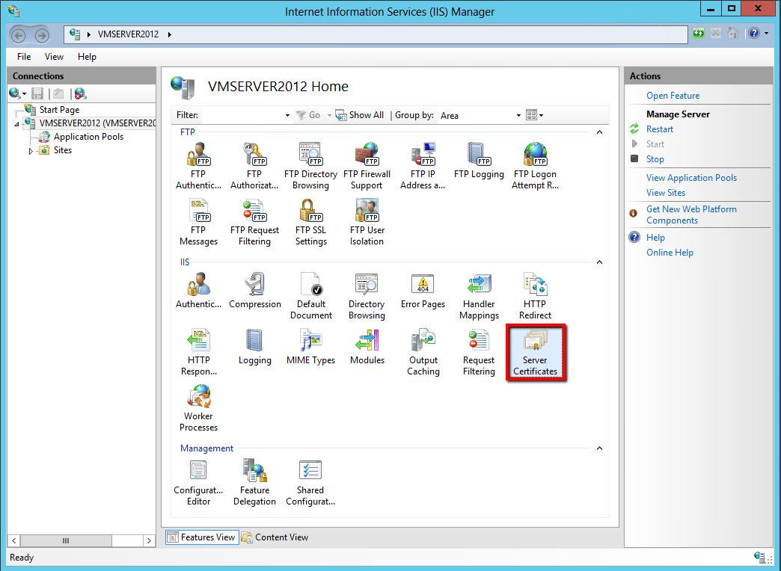
Connections
Here you can view your websites (they can be FTP sites or actual HTTP sites)

Slide 6
IIS options. You can also add certificates to turn your HTTP server into HTTPS

Slide 7
Server Actions
Options to restart, start, and stop server
Restarts might be needed after security changes are made
View Application Pools
View Sites

Slide 8

What’s an Application Pool?
All IIS websites run under the w3wp.exe process
You can have multiple instances of w3wp.exe running, where each process hosts a different set of websites
Some application pools of w3wp may have higher access rights than other pools

Slide 9
Application Pool Functions
Allows you to
run different websites under different users
run different websites under different frameworks (.Net Framework 2.0 or 4.0, etc)
run different websites under different bit versions (32 and 64)
Multiple pools will take more memory, however

Slide 11
More on “More on Web Server IIS”
Kernel Mode → complete access to connected hardware
Can execute any command
Used for trusted processes
User Mode → execute commands short of accessing hardware or reference memory
Delegates APIs to interact with
Microsoft IIS is kernel mode, so it is faster and has access to non-paged memory, CPU time-slices

Slide 12
How to Install and Configure IIS
Control Panel → Add or Remove Programs → Add/Remove Windows Components → Check “Internet Information Services (IIS)” → “Next” → “Finish”
On Server: Server Manager → Add Roles and Features → follow the steps in the window, under roles expand IIS and choose the specific role you want → finish through the installation

Slide 13
Where to Manage?
IIS Manager = GUI
The better manager (no SMTP)
Can add FTP sites or websites, manage site logs, configure security settings, etc…
IIS Manager 6.0
IIS Manager w SMTP
Win + R: inetmgr
Search IIS Manager and click to open :D

Slide 14
Configuration/Security Settings
Users should not have ability to directory browse, but only specific path
Open IIS Manager → navigate to level you want to manage → Features View → Directory Browsing → Actions Pane → Disable
Enable logging
ServerName → expand Web Sites or FTP Sites → right-click either where you want to enable logging → click Properties → Click Web Site or FTP Site Tab → select Enable logging
Alternatively IIS Manager → Logging → Turn logging on
Open ports for service
Firewall will block unspecified ports by default. Enable the ports required by your server

Slide 15
Configuration/Security Settings
Make sure only authorized users can access UNLESS site is meant to be anonymously accessible
Control Panel → Programs and Features → Turn Windows features on or off → IIS Services (expand) → World Wide Web Services (expand) → expand Security → select URL Authentication
In IIS Manager, go to Authentication and Disable Anonymous Authentication

Slide 16
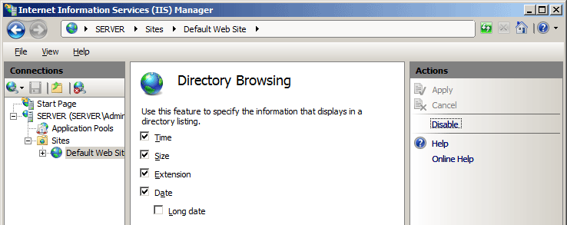
Click Disable on the right side, and don’t forget to Apply
Might need to restart server for changes to take effect

Slide 17
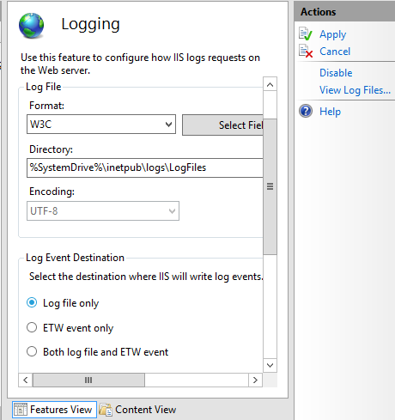
Enable logging

Slide 18
Want To Know More?
https://www.cisecurity.org/benchmark/microsoft_iis/

